Slide 1
Big Data Infrastructure
CS 489/698 Big Data Infrastructure (Winter 2016)
Week 11: Analyzing Graphs, Redux (2/2)
March 24, 2016
Jimmy Lin
David R. Cheriton School of Computer Science
University of Waterloo
These slides are available at http://lintool.github.io/bigdata-2016w/
This work is licensed under a Creative Commons Attribution-Noncommercial-Share Alike 3.0 United States See http://creativecommons.org/licenses/by-nc-sa/3.0/us/ for details

Slide 2
Theme for Today:
How things work in the real world
(forget everything I told you…)

Slide 3




From the Ivory Tower…
Source: Wikipedia (All Souls College, Oxford)

Slide 4
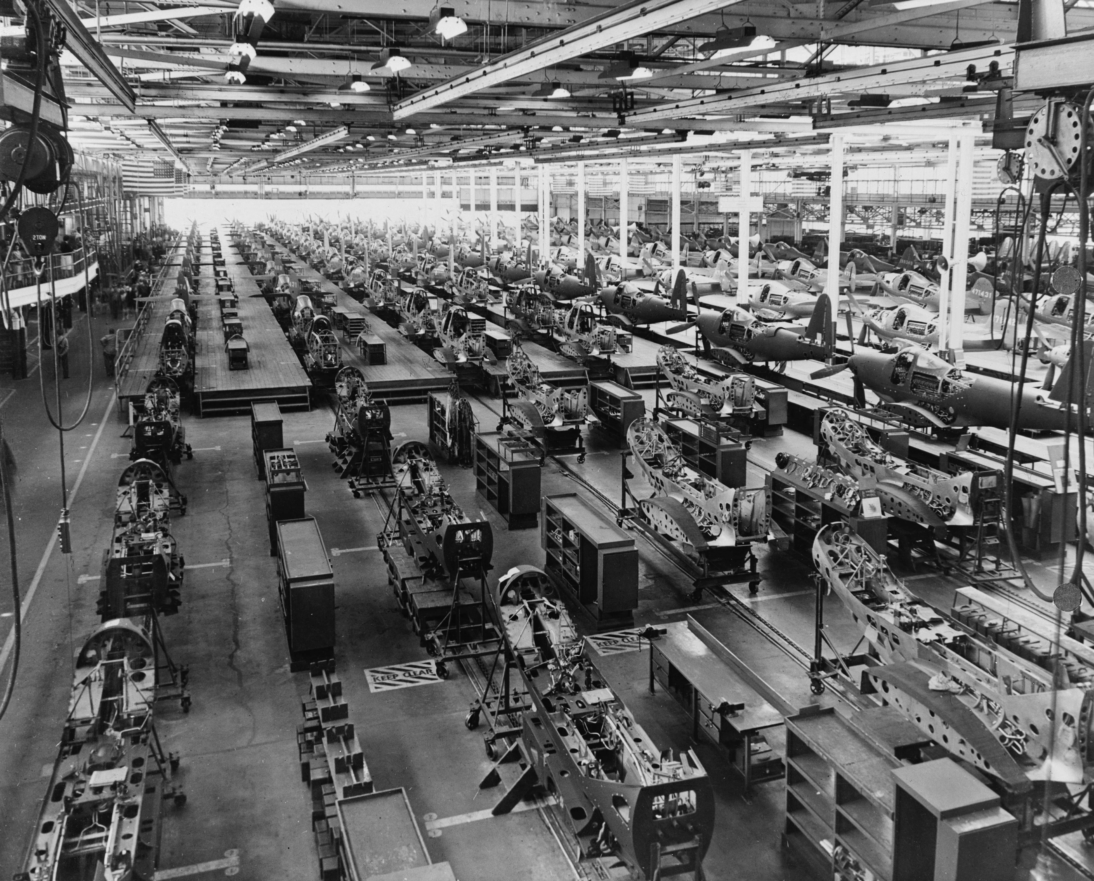

… to building sh*t that works
Source: Wikipedia (Factory)

Slide 5

… and back.
Source: Wikipedia (All Souls College, Oxford)

Slide 6
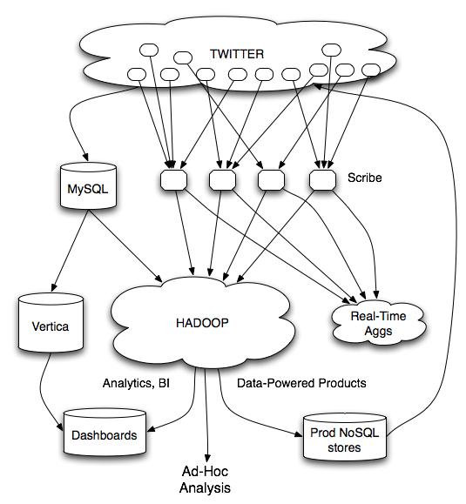
data products
data science
I worked on…
– analytics infrastructure to support data science
– data products to surface relevant content to users

Slide 7
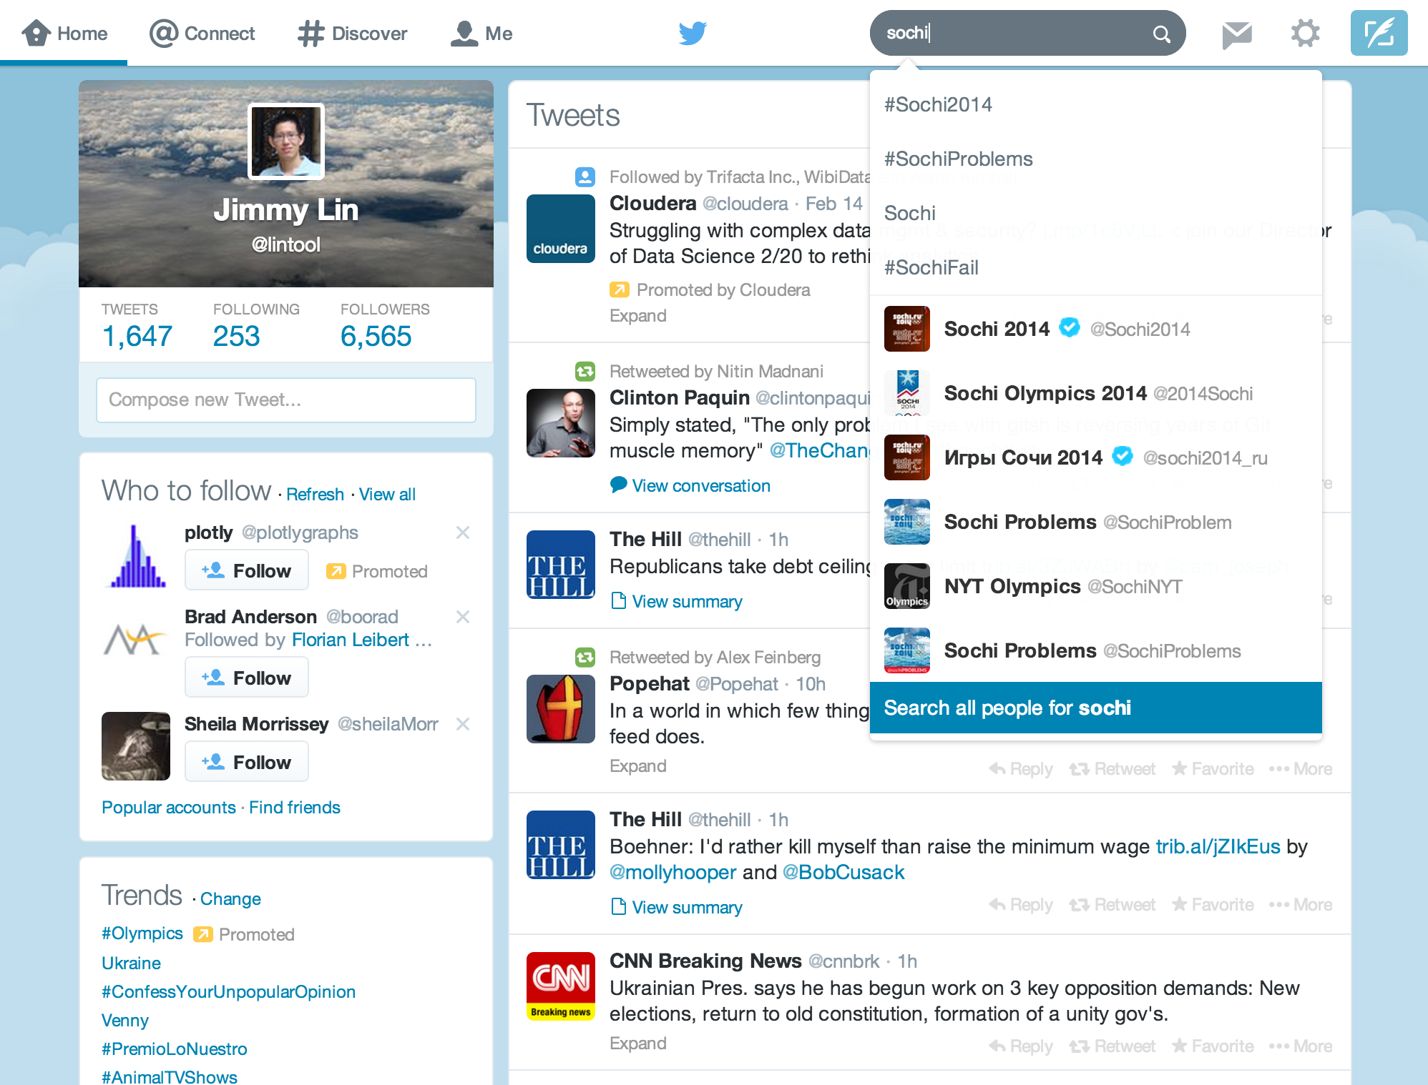
Busch et al. Earlybird: Real-Time Search at Twitter. ICDE 2012
Mishne et al. Fast Data in the Era of Big Data: Twitter's Real-Time Related Query Suggestion Architecture. SIGMOD 2013.
Leibert et al. Automatic Management of Partitioned, Replicated Search Services. SoCC 2011
Gupta et al. WTF: The Who to Follow Service at Twitter. WWW 2013
Lin and Kolcz. Large-Scale Machine Learning at Twitter. SIGMOD 2012
I worked on…
– analytics infrastructure to support data science
– data products to surface relevant content to users

Slide 8
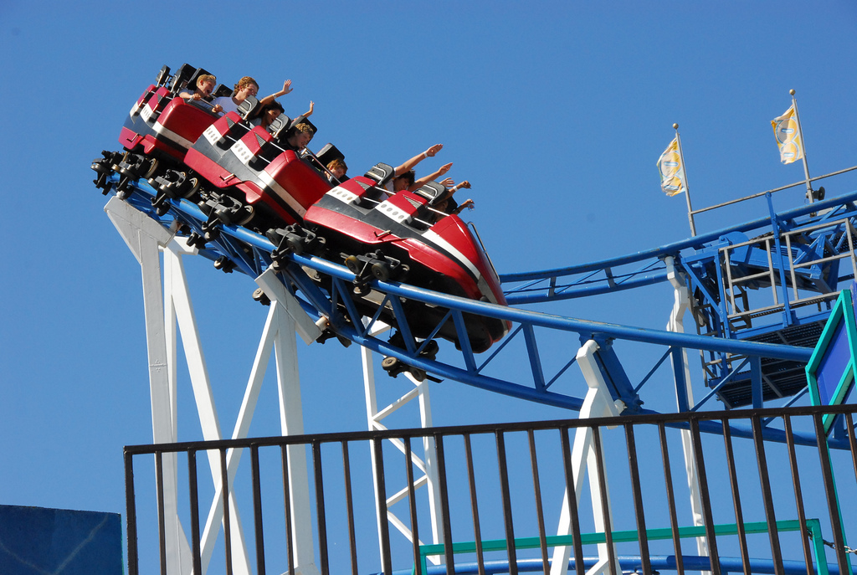
Source: https://www.flickr.com/photos/bongtongol/3491316758/

Slide 9
circa ~2010
~150 people total
~60 Hadoop nodes
~6 people use analytics stack daily
circa ~2012
~1400 people total
10s of Ks of Hadoop nodes, multiple DCs
10s of PBs total Hadoop DW capacity
~100 TB ingest daily
dozens of teams use Hadoop daily
10s of Ks of Hadoop jobs daily

Slide 10


WTF
(who to follow)
(whom to follow)
Launched summer 2010

Slide 11
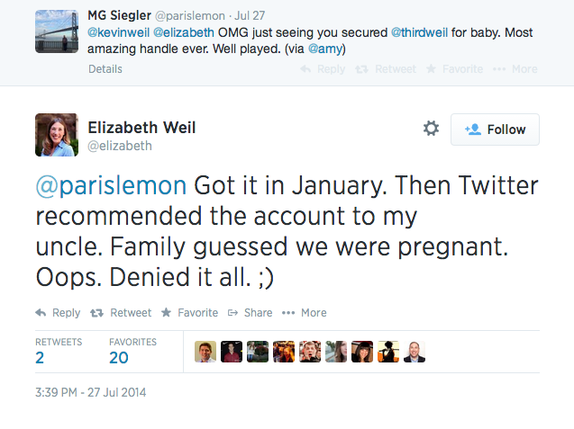

Slide 12
#numbers
(Second half of 2012)
~175 million active users
~20 billion edges
42% edges bidirectional
Avg shortest path length: 4.05
40% as many unfollows as follows daily
WTF responsible for ~1/8 of the edges
Myers, Sharma, Gupta, Lin. Information Network or Social Network? The Structure of the Twitter Follow Graph. WWW 2014.

Slide 13
A talk in three episodes…
Prologue

Slide 14
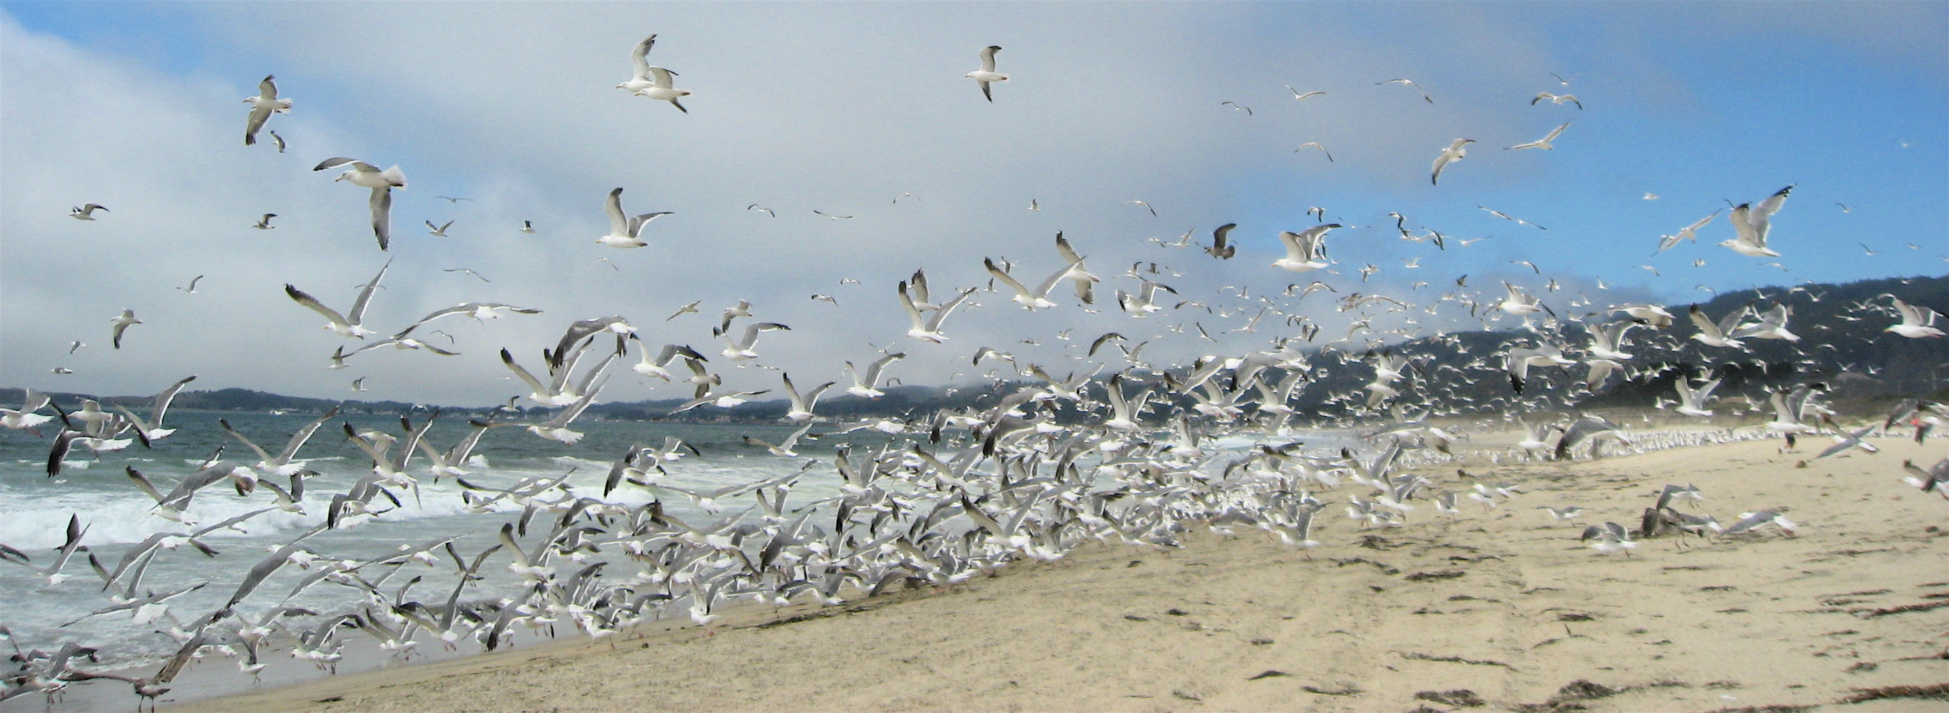
flockDB
(graph database)
Simple graph operations
Set intersection operations
Not appropriate for graph algorithms!

Slide 16
Use Hadoop!
MapReduce sucks for graph algorithms…
Java verbosity
Long task startup
Stragglers
Needless graph shuffling
Frequent checkpointing

Slide 17
What about?
HaLoop (VLDB 2010)
Twister (MapReduce Workshop 2010)
Pregel/Giraph (SIGMOD 2010)
Graphlab (UAI 2010)
PrIter (SoCC 2011)
Datalog on Hyracks (Tech report, 2012)
Spark/GraphX (NSDI 2012, arXiv 2014)
PowerGraph (OSDI 2012)
GRACE (CIDR 2013)
Mizan (EuroSys 2013)
…

Slide 18


Cassovary
Circa 2010

Slide 19
MapReduce sucks for graph algorithms…
Let’s build our own system!
Key design decision:
Keep entire graph in memory…
on a single machine!

Slide 20
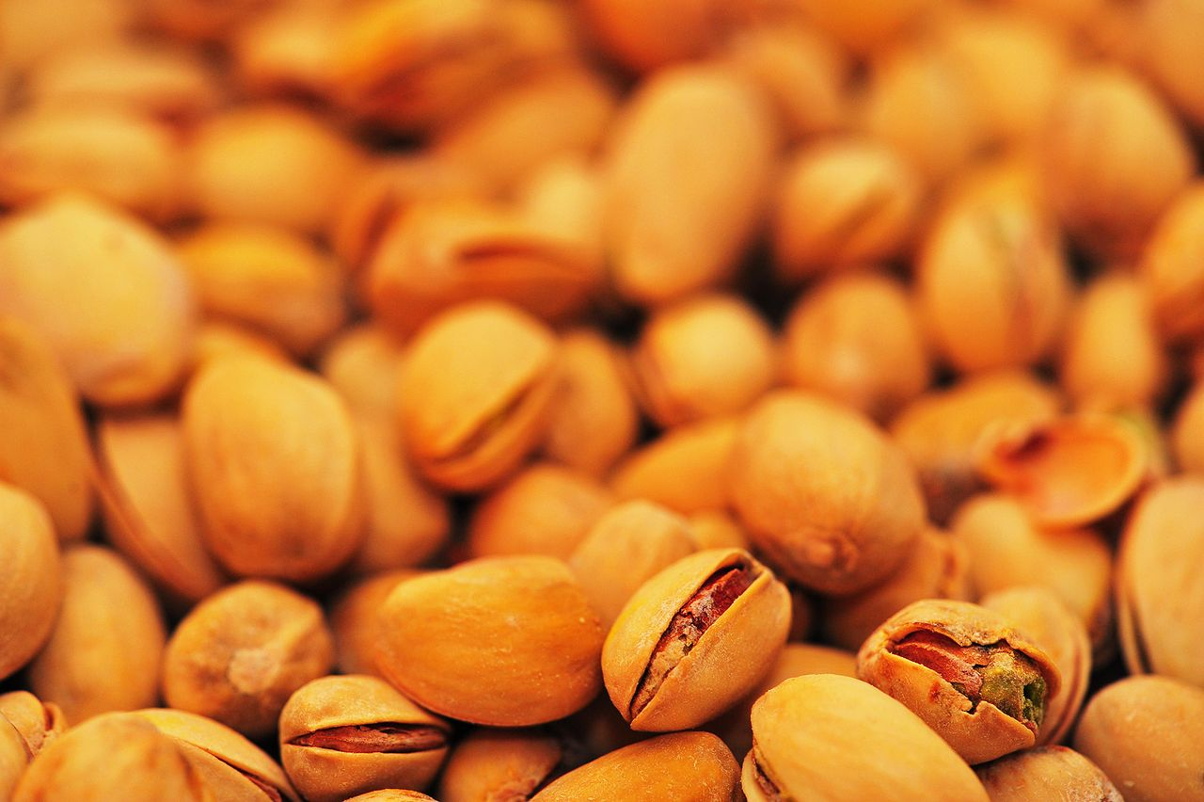
Nuts!
Why?
Because we can!
Graph partitioning is hard… so don’t do it
Simple architecture
Right choice at the time!
Source: Wikipedia (Pistachio)

Slide 21
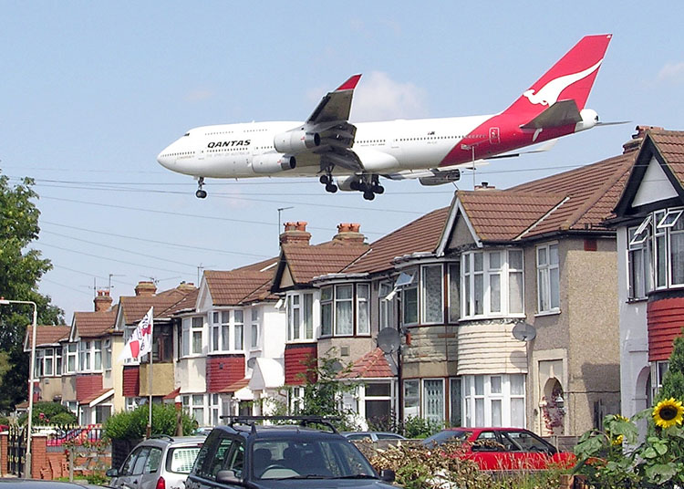
The runway argument
Source: Wikipedia (Heathrow)

Slide 22
Suppose: 10×10⁹ edges
(src, dest) pairs: ~80 GB
18 × 8 GB DIMMS = 144 GB
18 × 16 GB DIMMS = 288 GB
12 × 16 GB DIMMS = 192 GB
12 × 32 GB DIMMS = 384 GB

Slide 23
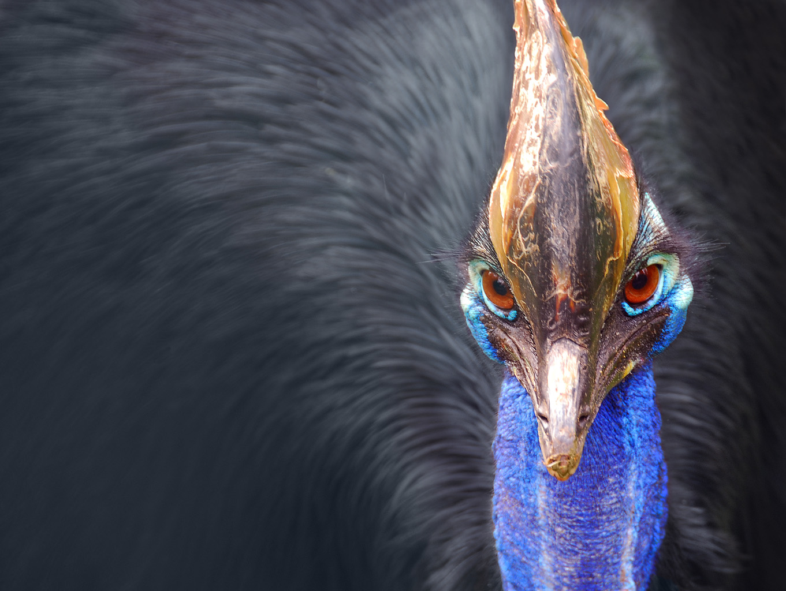
Cassovary
In-memory graph engine
Implemented in Scala
Compact in-memory representations
But no compression
Avoid JVM object overhead!
Open-source
Source: Wikipedia (Cassowary)

Slide 24
PageRank
“Semi-streaming” algorithm
Keep vertex state in memory, stream over edges
Each pass = one PageRank iteration
Bottlenecked by memory bandwidth
Convergence?
Don’t run from scratch… use previous values
A few passes are sufficient

Slide 25
“Circle of Trust”
Ordered set of important neighbors for a user
Result of egocentric random walk
Computed online based on various input parameters
One of the features used in search
“circle of trust”

Slide 26
SALSA for Recommendations
“authorities”
“hubs”
hubs scores: similarity scores to u
authority scores: recommendation scores for u
CoT of u
users LHS follow

Slide 27
Goel, Lin, Sharma, Wang, and Zadeh. WTF: The Who to Follow Service at Twitter. WWW 2013

Slide 28
Blender
Fetcher
WTF DB
FlockDB
HDFS
Cassovary

Slide 29
Blender
Fetcher
What about new users?
Cold start problem: they need recommendations the most!
WTF DB
FlockDB
HDFS
Cassovary

Slide 30
Blender
Fetcher
Fetcher
Real-time Recommendations
WTF DB
FlockDB
HDFS
Cassovary

Slide 31
Spring 2010: no WTF
seriously, WTF?
Summer 2010: WTF launched

Slide 32

Hadoop
Circa 2012

Slide 33
Another “interesting” design choice:
We migrated from Cassovary back to Hadoop!
Source: Wikipedia (Pistachio)

Slide 34
Whaaaaa?
Cassovary was a stopgap!
Hadoop provides:
Richer graph structure
Simplified production infrastructure
Scaling and fault-tolerance “for free”
Right choice at the time!

Slide 35
Wait, didn’t you say MapReduce sucks?
What exactly is the issue?
Random walks on egocentric 2-hop neighborhood
Naïve approach: self-joins to materialize, then run algorithm
The shuffle is what kills you!

Slide 36
Graph algorithms in MapReduce
Tackle the shuffling problem
Key insights:
Batch and “stich together” partial random walks*
Clever sampling to avoid full materialization
* Sarma et al. Estimating PageRank on Graph Streams. PODS 200
Bahmani et al. Fast Personalized PageRank on MapReduce. SIGMOD 2011.

Slide 37
Throw in ML while we’re at it…
Follow graph
Retweet graph
Favorite graph
…
Candidate Generation
Trained Model
Candidates
Classification
Final Results
Lin and Kolcz. Large-Scale Machine Learning at Twitter. SIGMOD 2012.

Slide 38

Custom Architectures
Circa 2013

Slide 39

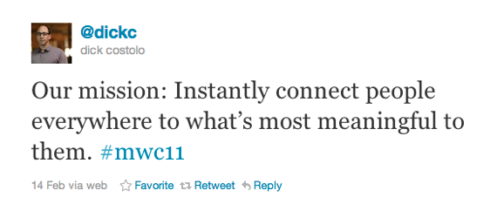
Isn’t the point of Twitter real-time?
So why is WTF still dominated by batch processing?
Source: Wikipedia (Motion Blur)

Slide 40
From batch to real-time recommendations:
Recommendations based on recent activity
“Trending in your network”
Inverts the WTF problem:
For this user, what recommendations to generate?
Given this new edge, which user to make recommendations to?

Slide 41
C₂
B₁
B₂
B₃
A
Why does this work?
A follows B’s because they’re interesting
B’s following C’s because “something’s happening”
(generalizes to any activity)
Gupta, Satuluri, Grewal, Gurumurthy, Zhabiuk, Li, and Lin. Real-Time Twitter Recommendation: Online Motif Detection in Large Dynamic Graphs. VLDB 2014

Slide 42
Scale of the Problem
O(10⁸) vertices, O(10¹⁰) edges
Designed for O(10⁴) events per second
Naïve solutions:
Poll each vertex periodically
Materialize everyone’s two-hop neighborhood, intersect
Production solution:
Idea #1: Convert problem into adjacency list intersection
Idea #2: Partition graph to eliminate non-local intersections
Gupta, Satuluri, Grewal, Gurumurthy, Zhabiuk, Li, and Lin. Real-Time Twitter Recommendation: Online Motif Detection in Large Dynamic Graphs. VLDB 2014

Slide 43
Single Node Solution
D “dynamic” structure: stores inverted adjacency lists
Who we’re recommending
query C, return all B’s that link to it
C₂
“influencers”
B_{i}
C_{j}
B₁
B₂
B₃
B_{i}
C_{j}
B_{i}
C_{j}
A
S “static” structure: stores inverted adjacency lists
Who we’re making the recommendations to
query B, return all A’s that link to it

Slide 44
Algorithm
D “dynamic” structure: stores inverted adjacency lists
Who we’re recommending
query C, return all B’s that link to it
C₂
1. Receive B₃ to C₂
“influencers”
2. Query D for C₂, get B₁, B₂, B₃
B₁
B₂
B₃
3. For each B₁, B₂, B₃, query S
4. Intersect lists to compute A’s
A
S “static” structure: stores inverted adjacency lists
Who we’re making the recommendations to
query B, return all A’s that link to it
Idea #1: Convert problem into adjacency list intersection

Slide 45
Distributed Solution
B_{i}
C_{j}
Who we’re recommending
Replicate on every node
C₂
1. Fan out new edge to every node
2. Run algorithm on each partition
3. Gather results from each partition
“influencers”
B₁
B₂
B₃
B₁
B₄
B₅
A
A₂
Partition by A
Who we’re making the recommendations to
Idea #2: Partition graph to eliminate non-local intersections

Slide 46
Notes
D “dynamic” structure: stores inverted adjacency lists
Who we’re recommending
Memory pressure?
C₂
“influencers”
B₁
B₂
B₃
Why?
A
S “static” structure: stores inverted adjacency lists
Who we’re making the recommendations to

Slide 47
Production Status
Launched September 2013
Push recommendations to Twitter mobile users
Billions of raw candidates, millions of push notifications daily
Performance
End-to-end latency (from edge creation to delivery): median 7s, p99 15s
Gupta, Satuluri, Grewal, Gurumurthy, Zhabiuk, Li, and Lin. Real-Time Twitter Recommendation: Online Motif Detection in Large Dynamic Graphs. VLDB 2014

Slide 48


Slide 49

Takeaway lesson #01:
Make things as simple as possible, but not simpler.
With lots of data, algorithms don’t really matter that much
Why a complex architecture when a simple one suffices?

Slide 50

Takeaway lesson #10:
Constraints aren’t always technical.
Source: https://www.flickr.com/photos/43677780@N07/6240710770/

Slide 51
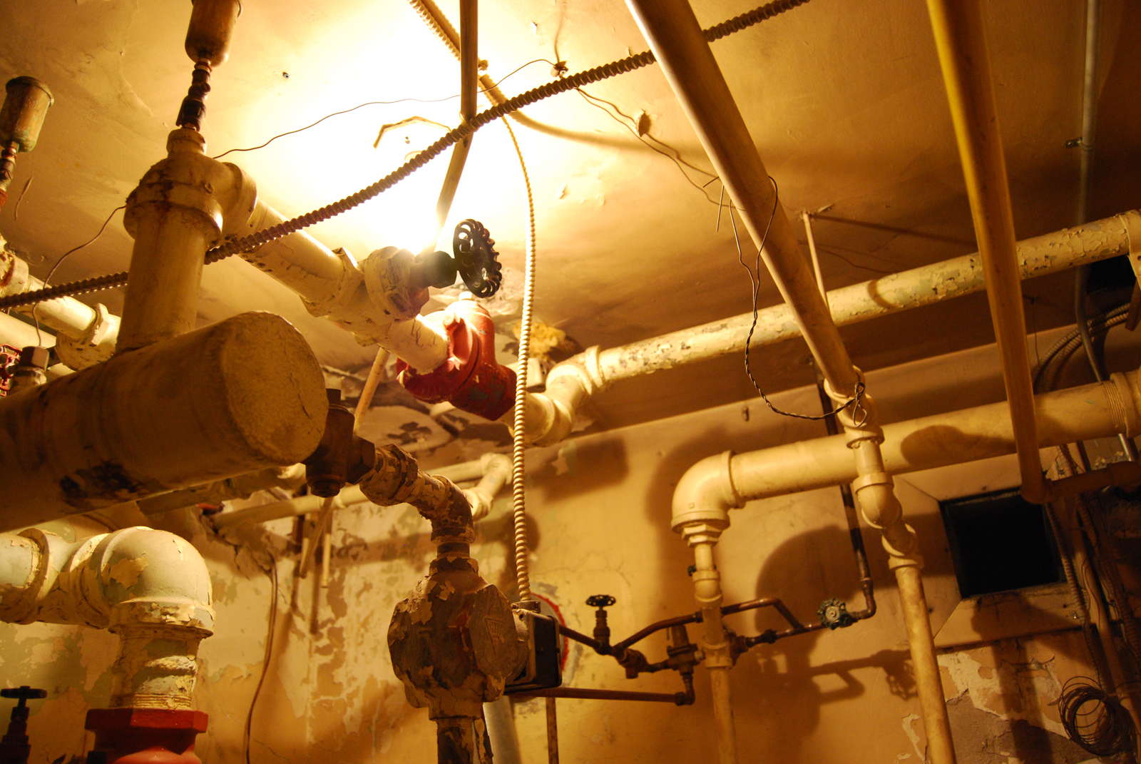
Takeaway lesson #11:
Plumbing matters. A lot.
Source: Wikipedia (Plumbing)

Slide 52

Questions?
“In theory, there is no difference between theory and practice. But, in practice, there is.”
- Jan L.A. van de Snepscheut
Twittering Machine. Paul Klee (1922) watercolor and ink

